Slide 1
Machine Learning Sign Language Understanding
Luís Fonseca nº 89066
Pedro Miguel nº 89069
TAA @ DETI UA – 2019/2020
Professora: Petia Georgieva

Slide 2
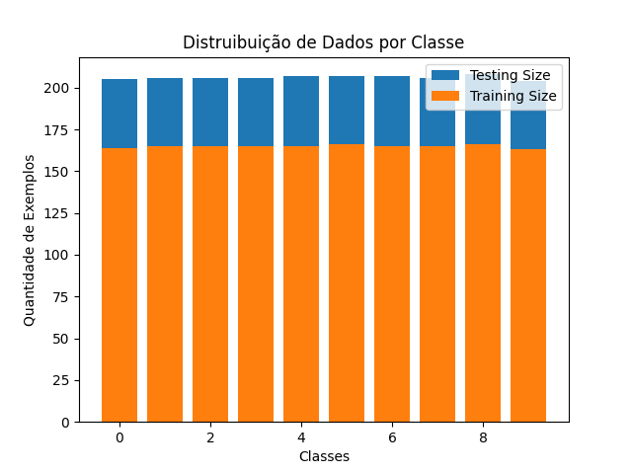
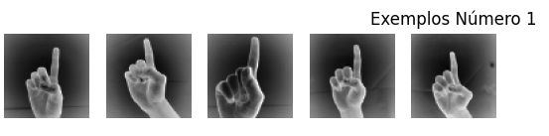
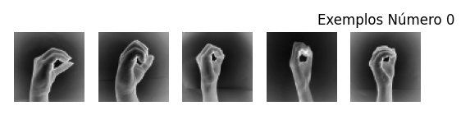
Os Dados

Slide 3
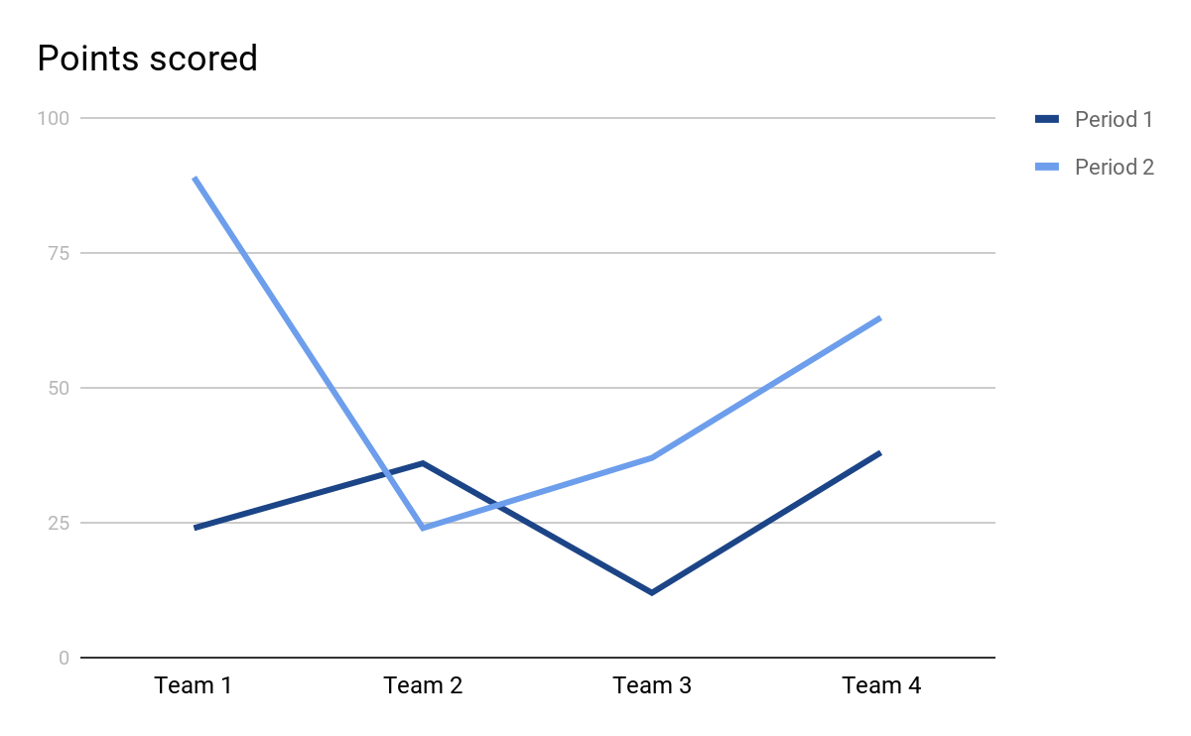


Considerações
tamanho: 64 x 64;
espaço de cores: cinza;
formato do ficheiro: npy
numero de classes: 10
numero de participantes: 218
numero de exemplos por participante: 10

Slide 4
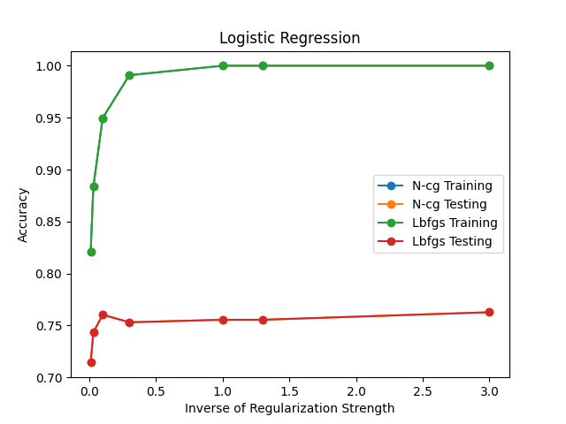
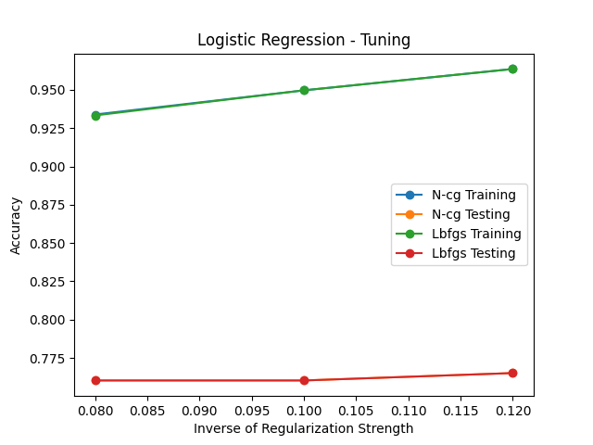
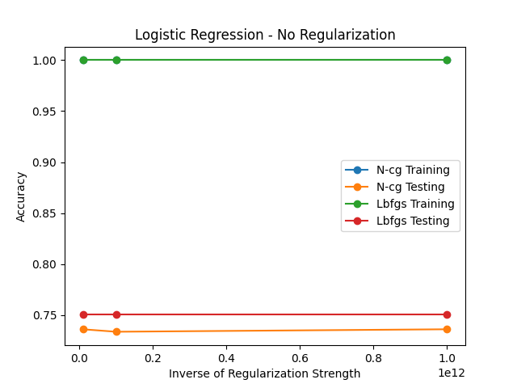
Logistic Regression

Slide 5
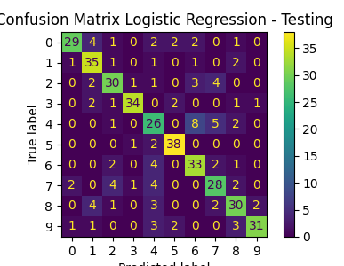
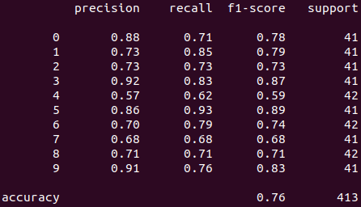
Logistic Regression
train accuracy: 0.9496664645239539
test accuracy: 0.7602905569007264

Slide 6
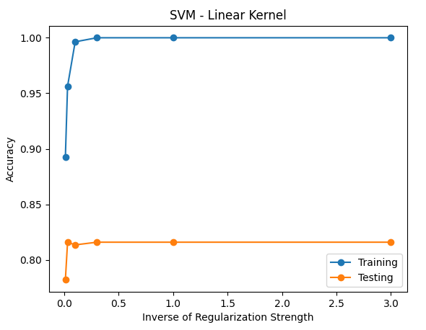

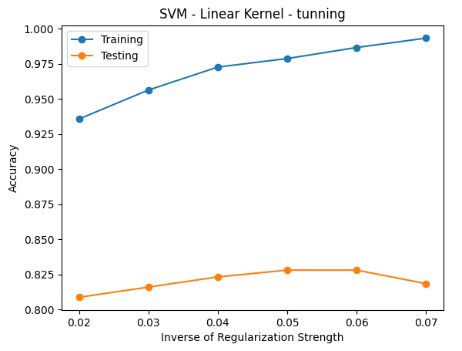
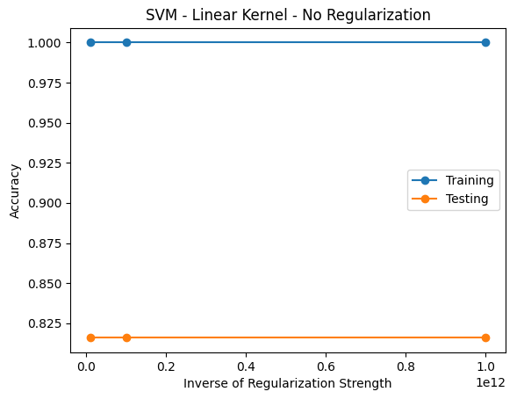
SVM – Linear Kernel

Slide 7
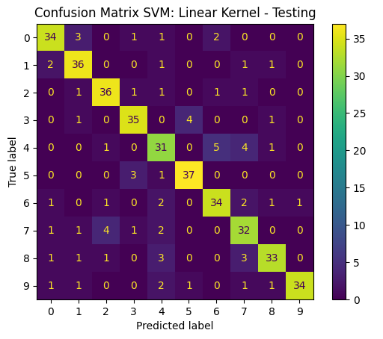
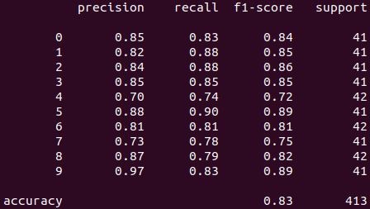
SVM – Linear Kernel
train accuracy: 0.9866585809581565
test accuracy: 0.8280871670702179

Slide 8
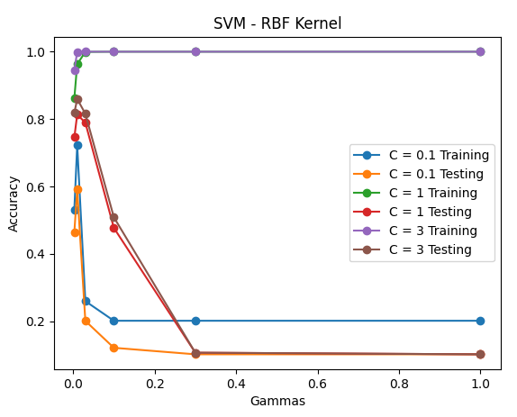
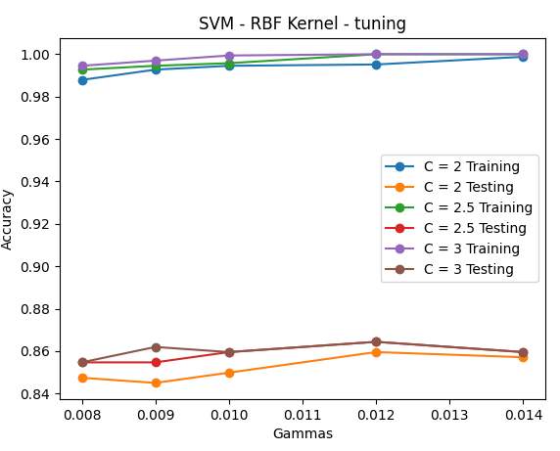
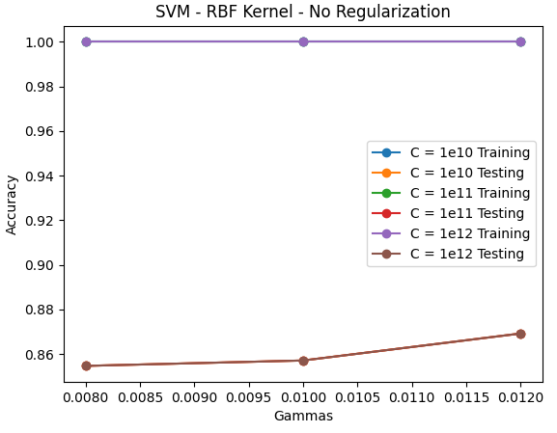
SVM – RBF Kernel

Slide 9
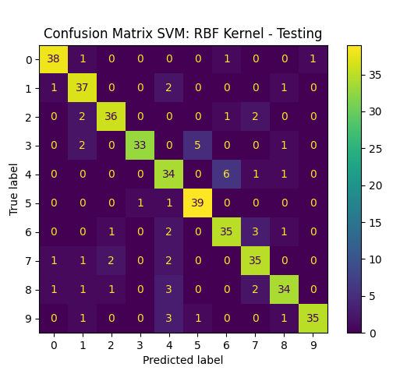
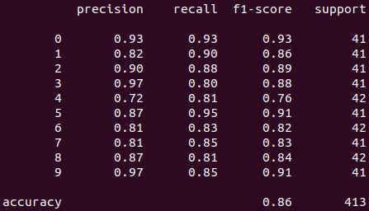
SVM – RBF Kernel
train accuracy: 0.9969678593086719
test accuracy: 0.8619854721549637

Slide 10
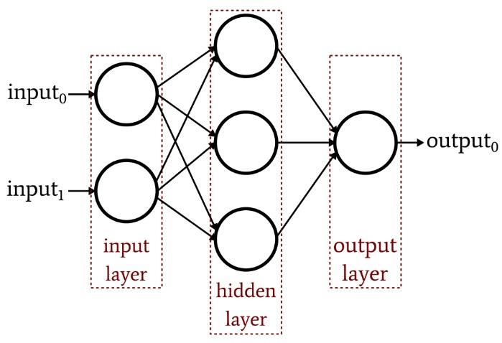
Neural Network - Multi-Layer Perceptron

Slide 11

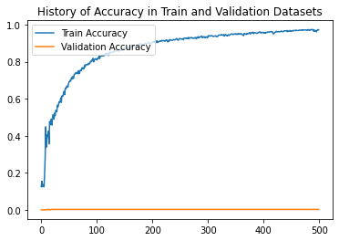
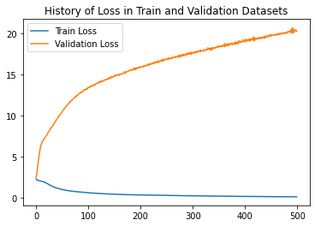
Neural Network - MLP

Slide 12
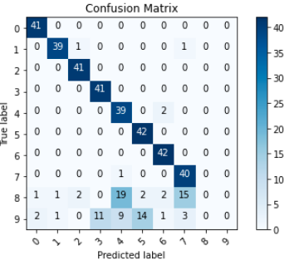
Neural Network - MLP
train accuracy: 0.7759456634521484
test accuracy: 0.765131424713135

Slide 13
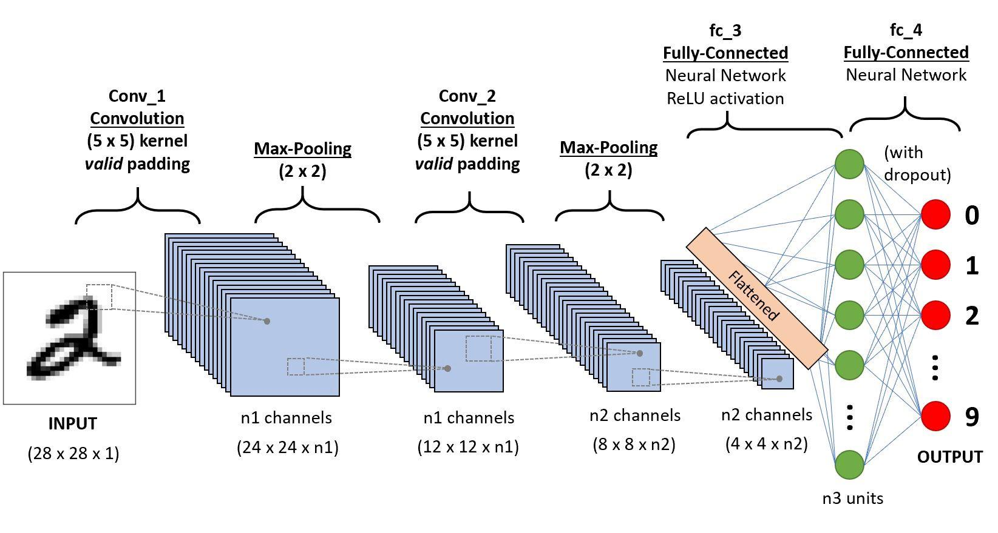
Neural Network- Convolutional Neural Network

Slide 14

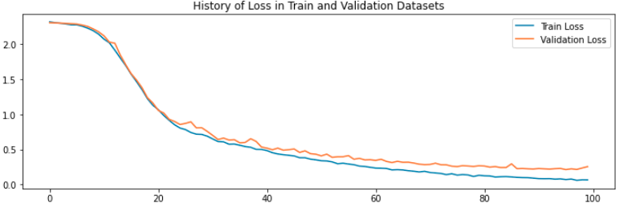

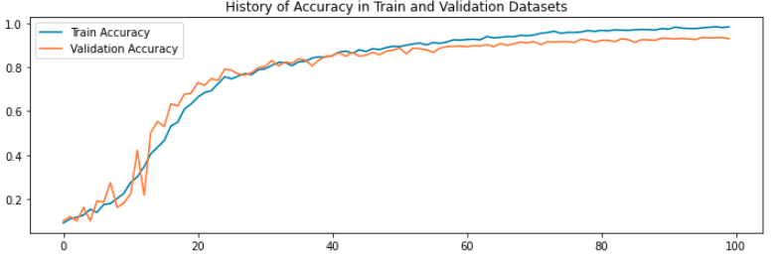
Neural Network - CNN

Slide 15
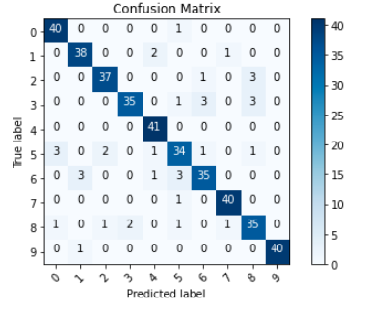
Neural Network - CNN
train accuracy: 0.9896907210350037
test accuracy: 0.9443099498748779

Slide 16
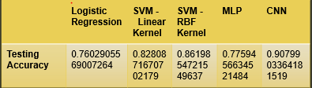
Conclusão
Principais Limitações
experiência
tamanho do dataset

